Slide 1
Disruptive Tipping Points
& the Principles Matrix
Have you factored in all of the problems your good idea has to address?
How to create a principles matrix

Slide 2

Why Bother: Disruption tipping points
Example = UK’s Sir Muir Gray’s stance re “no more money, patient driven change & value centric system change”
Many many wicked problems, pain, threats as well as opportunities
“Please factor in my data” “We want to audit you & the data we relied upon to make that decision”. Technology has tended to aggregate the risks & liability along with the data to a new unsuspecting custodian
Apps & integrating multiple systems tend not to work for:
Administrators
Clinicians
Patient/health consumers

Slide 3
Patient centricity: New requirements
Example = Relate to what my experience is today, what my needs are & can it work to get me to where I aspire to be
An app has to be at least:
Relevant to my/our needs including what I/we deem to be sacred
Truthful, trustworthy, verifiable, accountable and complete
Or meaningful and measurable value now, as well as the ability to help me get to where I need to be

Slide 4
The architect’s dilemma : Gulp!
Do we control, build, operate & be responsible for everything other than non-compliance including risks, liabilities & cost?
Or
Establish a governance framework, enable compliance for end to end automated processes/procedures and enforce the agreed rules of any accredited exchange
So
Do I stay on my/our fragmented island/s or learn to coexist with every interconnected system, device, service person or robot?

Slide 5
Some characteristics of disruptive tipping points
Demonstrable pain reduction & increase in meaningful value
Exponential change in cost, growth in capacity & adoption
Dramatic optimization
Follows a typical steep S curve adoption pathway
Some parties or services get chopped out of the equation
High synergistic impact between multiple disruptive tipping points
Higher impact of disruption originating from outside the sector
Cascading demand via viral marketing & crowd sentiment
Shorter time frame if demand and supply become aggregated
2

Slide 6
Examples of exponential change: Vehicles
Hybrid global corporations owning, insuring, financing & controlling the majority of vehicles in use (as a service)
More convenient & les cost to share in high density
Vehicle asset utilization shifts from 96% time parked to 80% usage
1 TeraFlop computer $46m in 2000 to $50 in 2017 for self drive vehicles
LIDAR self drive system down from $70k in 2102 to $250
Demand for self-drive = India 86%, China 70% & Brazil 80% - Now
Reverse auction of solar power drops to 2.62 Indian Rupee (0.051 Australian Dollar)

Slide 7
Example of exponential change: Energy
Solar capacity 12 fold increase over last 8 years + ownership shift
Solar & storage parity = domestic + commercial
Utilities shift from fighting to embracing renewables
Virtual power plants
Block-chain distributed aggregation of demand
Greenfield & community developers go micro network
Institutional investor sentiment shifting re risk of generation/transmission assets becoming stranded

Slide 8

Defining the synergistic maturity pathways
Individual Mega-trends & economic drivers
Today
Understood or embraced
A digital disruption tipping point
Looking back
from the future
example:
Smart City Optimized vehicle usage & cost
example:
Rooftop solar
&
Ride sharing
Virtual energy networks where % of assets owned by 3rd parties
Solar generation & storage parity with generation
The cost of vehicle use in USA will drop from $12,000 PA to $1,200 via sharing
5

Slide 9
So what are the implications? Example = All aspects of transportation infrastructure & assets
Tipping points of disruption
& value realization opportunities
Sufficient digital data from systems, sensors & devices to apply real-time & predicted analytics to match demand & supply so as to plan, build and operate total asset capacity to yield maximum public & commercial value. Quantum & fuzzy logic will be used for predicting what capability mix yields the most value for planning, management and consumption
Today
Understood and/or embraced by the enterprise
Connected analytics to comprehend capability & intent of movement
Information convergence of everything connected
Vehicle asset utilization shifts from 96% time parked to 80% usage for private & similar trend for commercial
Convergence with energy sector digital data & analytics
Convergence of most systems + ITS, planning, build & manage
Cheaper & more convenient not to own a vehicle in high density cities ($12k to $1,200 PA)
Joined up digital sector wide
Vehicle manufacturers shift to a pay as you use model
National role will shift towards overarching governance & facilitating conditions for collaboration and the brokerage activities within the context of a Smart Nation policy
Vehicle use optimization
Freight corridors
Regional & inter-regional optimization freight, commercial & private
Intermodal terminals
People exchanges & vehicle pooling
Logistic exchanges HUBs
Bi Modal
Newfound capacity for financiers to clip all transaction types relating to mobility within the eco system as commoditization engulfs all aspects. Plus gain rights or own digital assets where the value may exceed the original investment
Finance
Unsolicited propositions to fund infrastructure in return for some value capture re development
Pay as you go for what you use & when (Freight & commercial first)
Governance compliance, judgements & enforcement
Points of truth & equation validation
(Commercialized)
Safe, secure automation of any procedure, process, workflow, operation, decision making, or movement that has defined rules
Automated violation & enforcement
Traffic management systems shift towards permissions & control similar to aviation trends
Imports, parts & 3D printing
Skill sets & workforce culture
Attraction to jobs/contracts/cultures that provide pathways towards greater skills, certainty & assurity
Multi skilled & knowledge orientated with high level of analytical skills
Connected sector wide, regional and Smart Nation environments where it’s possible to leverage the synergistic value between multiple types of infrastructure & sectors though the use of digital capabilities
Clearly defined end points
Measurable value used as benchmarks
Regional & Nation digital economies
Smart regions

Slide 10
Smart City
Key disruption points that will impact Energy
Today
Understood and/or embraced by the enterprise
Commoditization
Reverse demand auctions
Reverse wholesale auctions
Optimized capacity & usage
Tariff
Regarded as stranded
Acceptable commercial pay back time frame
Acceptable domestic pay back timeframe
Assets
Solar ownership = user
Ownership switch to user, generator & storage
Costs
Solar achieves parity
Storage achieves parity
Underpin regional
vibrancy
Green field
Micro networks -self sufficient
Micro networks –spare capacity
Community
Distributed demand
Demand aggregation drives change
Synergistic- energy usage
Digital mesh
Synergistic- energy infrastructure
State of
non- repudiation
Synergistic- multi sectors
Governance
All rules & Law
Truthful
Non- compliance
Liability/risk mitigation

Slide 11
Smart City
Key digital disruption that will impact all sectors
Quantum logic
Ambiguity deals with exceptions
Today
Understood and/or embraced by the enterprise
Automation
Digital
Economies
Intelligent Bots
Digital assets
AI
Knowledge of what works
Smart Cities regions/nations
Multi system/party process automation
Machine-learning
Procurement
Utilities
Business process automation
Convergence
Real time pricing
Customer devices
IOT
Connectivity
commoditization
Enterprise Core systems
Suppliers systems
Market sectors
Brokerages
Multi Clouds
Digital rights
Fuzzy rules can work
Fledgling
sharing Economy
Accommodation
Governance
Embedded Legal instruments
Transport
Digital contracts
Standards
Laws (Multi distortional)
Liabilities/risk
Crowds
Collective decision making
Market sector orientation
Business agreements
Consent
Member based groups
Regulations
Holistic security
Common interest
Religious groups
Professional e-Guilds
Excluded
Asset evaluation
Value capture
Value based
Culture
Collaboration
Trust
Values
Decision making
Exponential growth of capacity or cost reduction
Electric vehicles
Driverless
Sentiment
Sharing
Demand aggregation
S-Curve Adoption
E- Guilds
Electricity generation
Workforce commoditization

Slide 12
Crime in a digital world
Key digital disruption that will impact all sectors
2025
2020
Digital crime occurrence, & value today
Pre-conditions of a Smart City (digital) environment
to meet the requirements of being safe, secure & function with vibrant commerce & community.
Today
Understood and/or embraced by the enterprise
Software Bots with Artificial intelligence & self learn
White collar
Currencies that underpin transactions of regional economies
Contracts
Cards (not present) Up 38%
Banking systems
Automated commodity trading regional hubs
Fraud
Bank robbery
Personal Identity certification & data
Digital Intellectual
property of a region
Neural networked eco like Cities that know everything about anything & everyone that is connected & shares information
Theft
Financial accounts
After sales 3D printed parts
Regional mobility private freight/Utilities
3D Printed Vehicles
Compliance
& authorization
Insurance
Driverless Vehicles
Home detention
Restrictions –movement/activity's
Non payment & collections
Licensees & permits
Tax
Regional governance & compliance frameworks
Fines
Social media
Ransoms of websites & accounts
Key:
What occurrence & magnitude of crime can a Smart City cope with?
Uncomfortable = (As is)
Unacceptable levels =?
Unworkable levels =?
Aggression &
intimidation
Business ID virtual premises
Regional digital immune
systems for resilience
Domestic Violence
Hacking
Oversight
Private security
IP ownership org/person
Governance of digital assets/ trade

Slide 13
Smart City
Key digital disruption that will impact all sectors
Quantum logic
Ambiguity deals with exceptions
Today
Understood and/or embraced by the enterprise
Automation
Digital
Economies
Payroll loss
30% of 60%
Digital crime tipping point
Digital assets
AI
Intelligent Bots
Smart Cities regions/nations
Knowledge of what works
Multi system/party process automation
Machine-learning
Procurement
Utilities
Business process automation
Convergence
Real time pricing
Customer devices
IOT
Connectivity
Extreme Weather
commoditization
Enterprise Core systems
Suppliers systems
Market sectors
Brokerages
Multi Clouds
Digital rights
Fuzzy rules can work
Impact - Tax
Corporate
Fledgling
sharing Economy
Accommodation
Governance
Embedded Legal instruments
Transport
Digital contracts
Standards
Laws (Multi distortional)
Liabilities/risk
Crowds
Collective decision making
Market sector orientation
Business agreements
Consent
Holistic security
Member based groups
Regulations
Health, non-affordability
Common interest
Religious groups
Professional e-Guilds
Excluded
Asset evaluation
Value capture
Culture
Collaboration
Values
Migration
Value based
Trust
Decision making
Exponential growth of capacity or cost reduction
Electric vehicles
Driverless
Sentiment
Sharing
Demand aggregation
S-Curve Adoption
E- Guilds
Electricity generation
Workforce commoditization

Slide 14
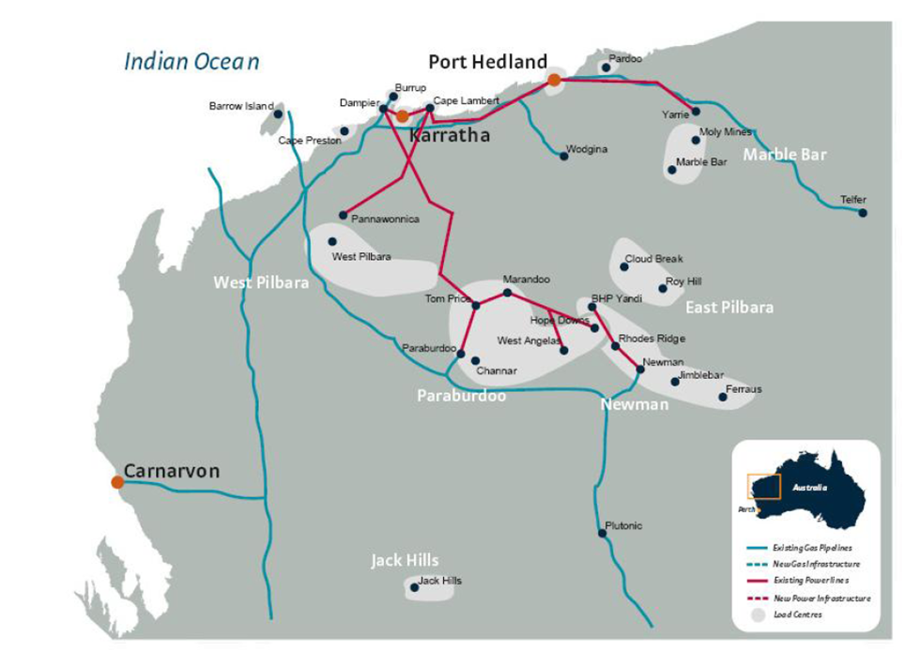
What solution set would work for this Wicked Problem in the Pilbara? Hypothetical
What is the Wicked problem? Holistic
What is & how much pain to whom? Holistic & operational
What are the interdependencies & required capabilities?
Commoditization
Optimized capacity & usage
Underpin regional
vibrancy
Gas
Power
State of
non-repudiation

Slide 15
Tasks Start to make your own cone map
Having researched the Mega Trends & Economic predictions from sources that are acceptable or even endorsed by your target audience:
Today
Understood and/or embraced by the enterprise
Your second task is to define the staged evolution pathway of each trend over a time line
?????
???????????
Your first task is to identify the most important
Mega Trends & Economic Drivers and list them here with the most important at the top as a TOPIC
Your third task is to define any symbiotic relationships between the trends that foster exponential change manifesting as S-curve adoption patterns
?????
Your fourth task is to identify the tipping point where things will never be quite the same again, as a direct consequence of these converging dynamics impacting the relationships of people, things (IoT), systems, sectors, economies & the eco-system itself
??????????????????

Slide 16
Smart City
Key digital disruption that will impact all sectors
Your next task determine the sequence of each tipping point identifying their interdependencies. For example connectivity must come first, automation cannot occur until sufficient governance exists to minimize business risk and financial liability which will be a prerequisite for adoption. The S-curve will cause convergence
Quantum logic
Ambiguity deals with exceptions
Today
Understood and/or embraced by the enterprise
Automation
Digital
Economies
Intelligent Bots
Digital assets
AI
Knowledge of what works
Smart Cities regions/nations
Multi system/party process automation
Machine-learning
Procurement
Utilities
Business process automation
Convergence
Real time pricing
Customer devices
IOT
Connectivity
commoditization
Enterprise Core systems
Suppliers systems
Market sectors
Brokerages
Multi Clouds
Digital rights
Fuzzy rules can work
Fledgling
sharing Economy
Accommodation
Governance
Embedded Legal instruments
Transport
Digital contracts
Standards
Laws (Multi distortional)
Liabilities/risk
Crowds
Collective decision making
Market sector orientation
Business agreements
Consent
Member based groups
Regulations
Holistic security
Common interest
Religious groups
Professional e-Guilds
Excluded
Asset evaluation
Value capture
Value based
Culture
Collaboration
Trust
Values
Decision making
Exponential growth of capacity or cost reduction
Electric vehicles
Driverless
Sentiment
Sharing
Demand aggregation
S-Curve Adoption
E- Guilds
Electricity generation
Workforce commoditization

Slide 17
Crime in a digital world
Key digital disruption that will impact all sectors
In this task you introduce the unexpected!! By you looking outside their field of vision (comprehension) to identify tipping points from spheres of influence that they would not normally see or believe will have any correlation to the events within their interconnected world
2025
2020
Digital crime occurrence & value today
Pre-conditions of a Smart City (digital) environment
to meet the requirements of being safe, secure & function with vibrant commerce & community.
Today
Understood and/or embraced by the enterprise
Software Bots with Artificial intelligence & self learn
White collar
Currencies that underpin transactions of regional economies
Contracts
Cards (not present) Up 38%
Banking systems
Automated commodity trading regional hubs
Fraud
Bank robbery
Personal Identity certification & data
Digital Intellectual
property of a region
Neural networked eco like Cities that know everything about anything & everyone that is connected & shares information
Theft
Financial accounts
After sales 3D printed parts
Regional mobility private freight/Utilities
3D Printed Vehicles
Compliance
& authorization
Insurance
Driverless Vehicles
Home detention
Restrictions –movement/activity's
Non payment & collections
Licensees & permits
Tax
Regional governance & compliance frameworks
Fines
Social media
Ransoms of websites & accounts
Key:
What occurrence & magnitude of crime can a Smart City cope with?
Uncomfortable = (As is)
Unacceptable levels =?
Unworkable levels =?
Aggression &
intimidation
Business ID virtual premises
Regional digital immune
systems for resilience
Domestic Violence
Hacking
Oversight
Private security
IP ownership org/person
Governance of digital assets/ trade

Slide 18
Smart City
Key digital disruption that will impact all sectors
Homework. In this task you introduce unquestionable risks of ignoring the obvious implications of the demonstrated tipping points of disruption!! This is achieved by thinking about them from a whole of systems perspective that includes the macro & micro all at the same time. It does take some practice to identify both the threat of disruption (magnitude & speed) as well as the opportunity that can be measured in terms of verifiable inherent value of the “good idea” as well as the value to the environment.
Quantum logic
Ambiguity deals with exceptions
Today
Understood and/or embraced by the enterprise
Automation
Digital
Economies
Payroll loss
30% of 60%
Digital crime tipping point
Digital assets
AI
Intelligent Bots
Smart Cities regions/nations
Knowledge of what works
Multi system/party process automation
Machine-learning
Procurement
Utilities
Business process automation
Convergence
Real time pricing
Customer devices
IOT
Connectivity
Extreme Weather
commoditization
Enterprise Core systems
Suppliers systems
Market sectors
Brokerages
Multi Clouds
Digital rights
Fuzzy rules can work
Impact - Tax
Corporate
Fledgling
sharing Economy
Accommodation
Governance
Embedded Legal instruments
Transport
Digital contracts
Standards
Laws (Multi distortional)
Liabilities/risk
Crowds
Collective decision making
Market sector orientation
Business agreements
Consent
Holistic security
Member based groups
Regulations
Health, non-affordability
Common interest
Religious groups
Professional e-Guilds
Excluded
Asset evaluation
Value capture
Culture
Collaboration
Values
Migration
Value based
Trust
Decision making
Exponential growth of capacity or cost reduction
Electric vehicles
Driverless
Sentiment
Sharing
Demand aggregation
S-Curve Adoption
E- Guilds
Electricity generation
Workforce commoditization

Slide 19
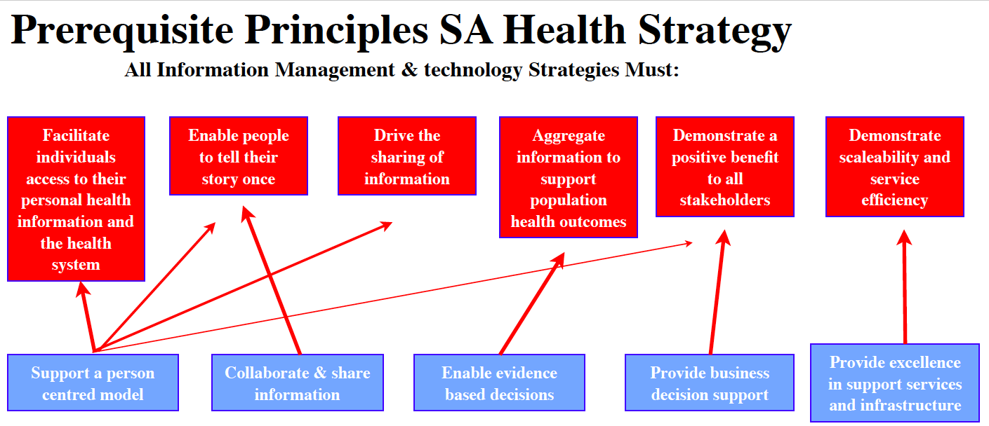
Overarching principles: Example

Slide 20
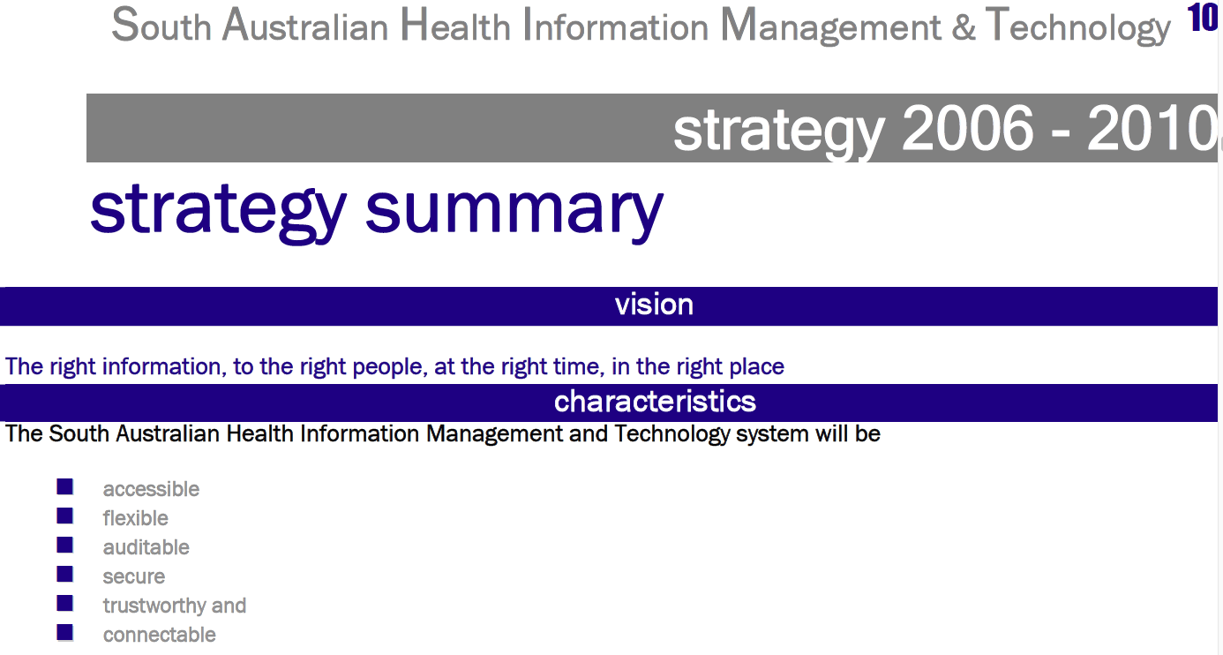
Overarching principles: Example

Slide 21
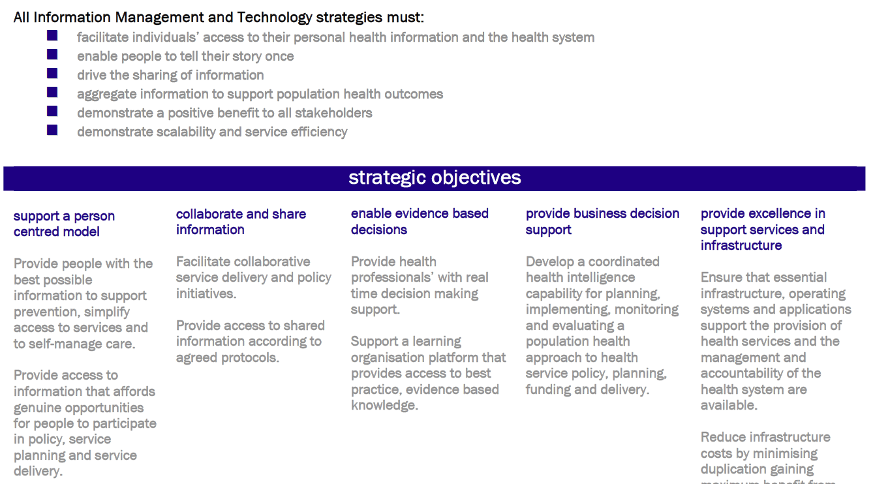
Overarching principles: Example

Slide 22
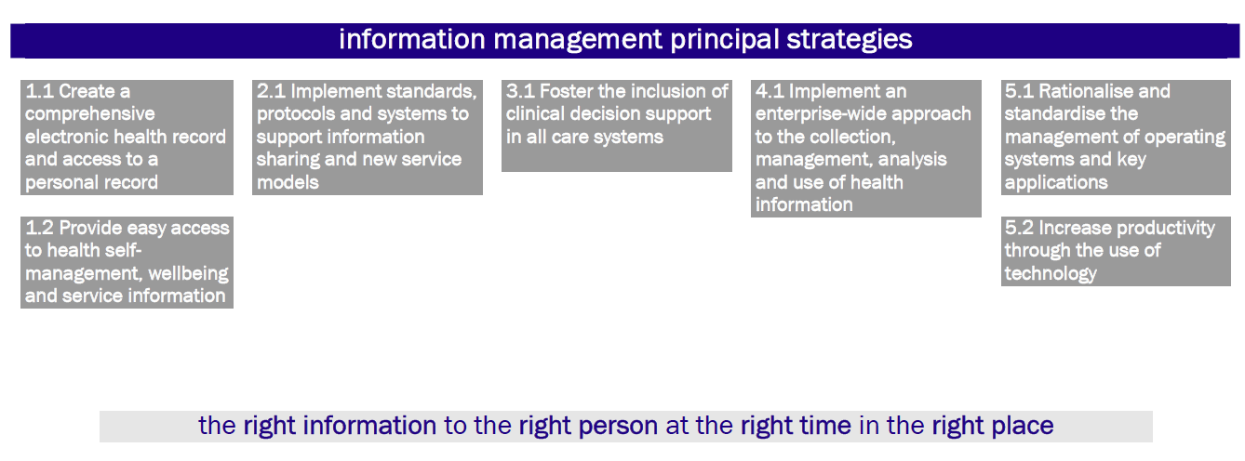
Overarching principles: Example

Slide 23
Principles Framework for any collaborative contribution to the overall Transport environment
Overarching and prerequisite principles that can not be violated by any rule, process, decision or act and defines what should be prioritised by its contribution to strengthening the principles matrix
Governable
Trustworthy
Collaborative
Effective
Valuable
Smart Regional
Must contribute to the region’s aspiration to become digitally interconnected with everything that is willing & able to be part of the fusion of big data
Must enable the establishment of at least one single point of visualization to enable connected regional analytics of capacity, capability & intent of mobility
Must enable regional adaptability to be responsive to the needs of urban, rural & remote community needs
Must enable a state of non repudiation for any digital activity including;
Regulations, industry standards, business agreements and individual or group consent
Must demonstrate capacity to manage or mitigate existing and new risk & liabilities and not aggregate the liabilities to an unsuspecting new custodian
Must demonstrate harmonization with other jurisdictions or demonstrate equal enhancements with regard to safety
Must be fair, transparent and accountable
Must be able to validate a defined degree of truthfulness of a single or multiple data point and validate any automated equation and status in real-time and to meet any retrospective audit requirement of the business, governance or safety
Must enable any authorized party to retrospectively audit any transaction, record, equation or decision within the context of the associated compliance rules at the exact time of the transaction or as requested.
Must establish two way meaningful relationships with consumers, groups, crowds, communities and organizations as a means of better understanding if the preconditions for collaboration can be improved
Must underpin the development of a robust collaborative economy by way of enabling the aggregation of both demand and supply capacity of the region
Must foster a culture of collaboration within the workforce and any partnerships to a point where sharing becomes the first option
Must contribute to the regional ability to be be responsive, flexible and agile
Must contribute to optimize individual and regional multimodality including reducing congestion
Must engender a sufficiently skillful workforce to match or exceed the market requirements including knowledge, Skills,
Must be able to demonstrate the ability to estimate, predict and validate the tangible & measurable intangible value to each operational person/role (and collective value) of the introduction of any proposed new capability prior to any funding decision
Must be able to unlock existing identified value potential, generate new types of value from the fusion of digital information & services and create new digital intellectual property and algorithms that are recognized by credit rating criteria
Must demonstrate capacity to utilize the combined reginal value to enable benchmarking, operational KPIs in a manner that can be incorporated into new type of Public, Private, Regional and even including crowds in partnerships
© Roadmap methodology copyright of Stephen Alexander

Slide 24
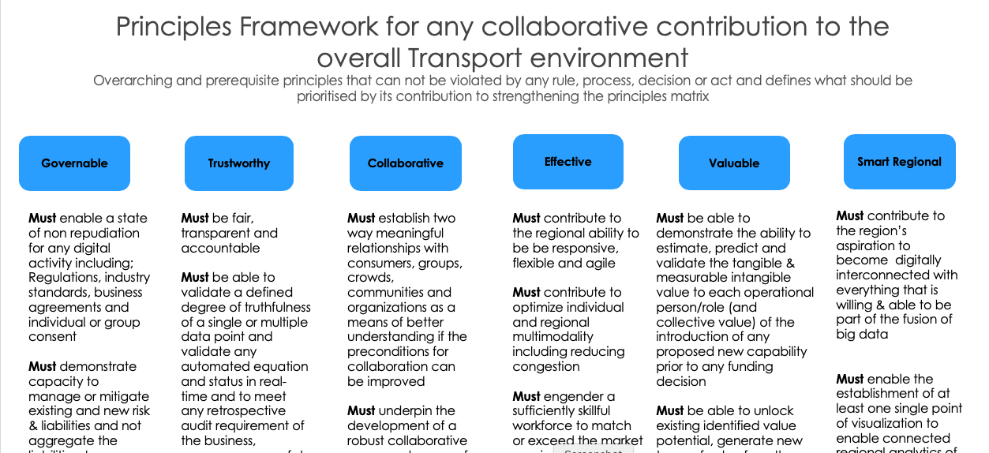
What would governance look like?
2

Slide 25
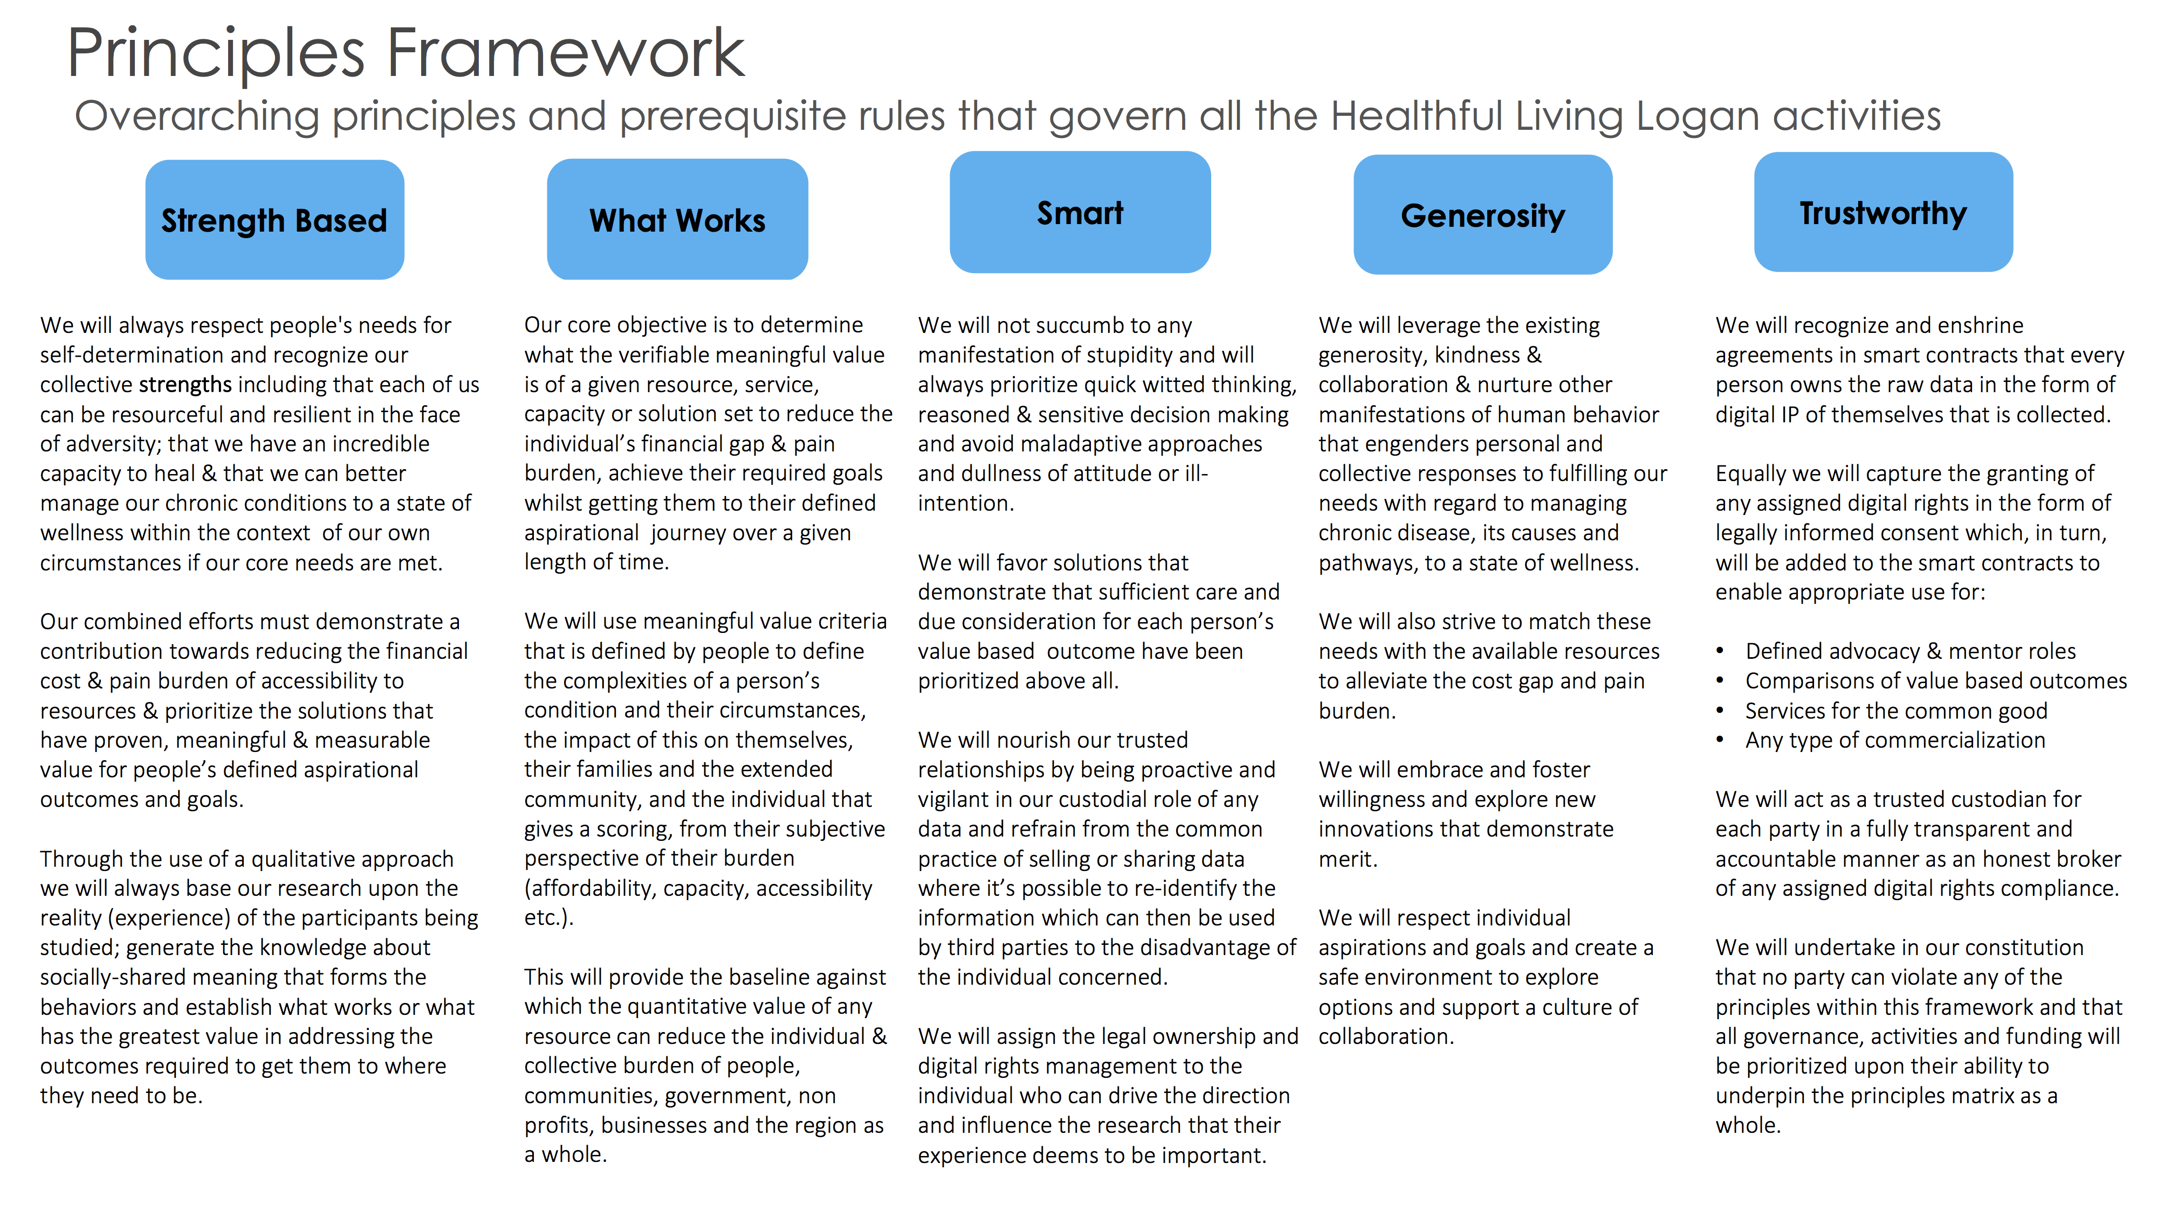
What would a patient-centric governance look like?
2

Slide 26
What would a patient-centric governance look like?
We will recognize and enshrine agreements in smart contracts that every person owns the raw data in the form of digital IP of themselves that is collected.
Equally we will capture the granting of any assigned digital rights re analytics in the form of legally informed consent which, in turn, will be added to the smart contracts to enable appropriate use for:
Defined advocacy & mentor roles
Comparisons of value based outcomes
Services for the common good
Any type of commercialization
2

Slide 27
Where best to start for consensus - Principles
A governance framework = To operate in a state of non-repudiation
Sacred overarching principles & compliance principles
Laws, regulations, rights, industry standards, enterprise protocols, business agreements, contractual standards, informed consensual arrangements/requests
Architecture team skill sets Tech savvy
Compliance (legal & tribal), Value (tangible & intangible) & Inter-relationships between systems, things, devices, services, people, AI, Robots (contextual ie supply chains, patient journeys)

Slide 28
Hult International Business School
www.hult.edu/
stephen.alexander@facility.hult.edu
stephen@stephenalexander.com.au
Blog https://www.stephenalexander.com.au/blog

